Slide 1
E-commerce
Group members:
G2302794C ANG SHU WEI
G2406170D HTEIK TIN MIN PAING
G2303232C JI HONGXIAO
G2302707A NONG MINH HIEU
G2302855K ZHANG DANRUI
G2406019J YE SHENGHUA
G2404083G DING JUNCHENG

Slide 2
Background of the Brazilian E-Commerce Public Dataset by Olist
Context
Olist is the largest department store in Brazilian marketplaces.
Connects small businesses from all over Brazil to channels without hassle and with a single contract.
Merchants on their platform can sell their products through the Olist Store and ship them directly to the customers using Olist logistics partners.
How it works?
After a customer purchases the product from Olist Store -> Seller gets notified to fulfill that order.
Once the customer receives the product or the estimated delivery date is due, the customer gets a satisfaction survey by email where he/she can give ratings and comments on his/her purchase experience.
Dataset
~100k+ of orders made at Olist from 2016 to 2018 made at multiple marketplaces in Brazil.
Information of customers, order items, order payments, order reviews, orders, products, sellers, product category name translation and geolocation datasets can be found.
Note:
An order might have multiple items.
Each item might be fulfilled by a distinct seller.
Real commercial data where names & references to the companies and partners in the review text are anonymized.

Slide 3
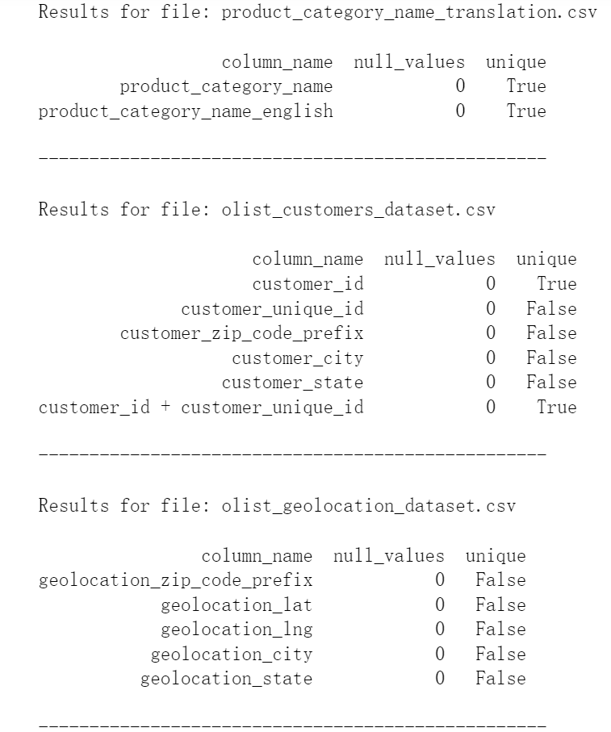
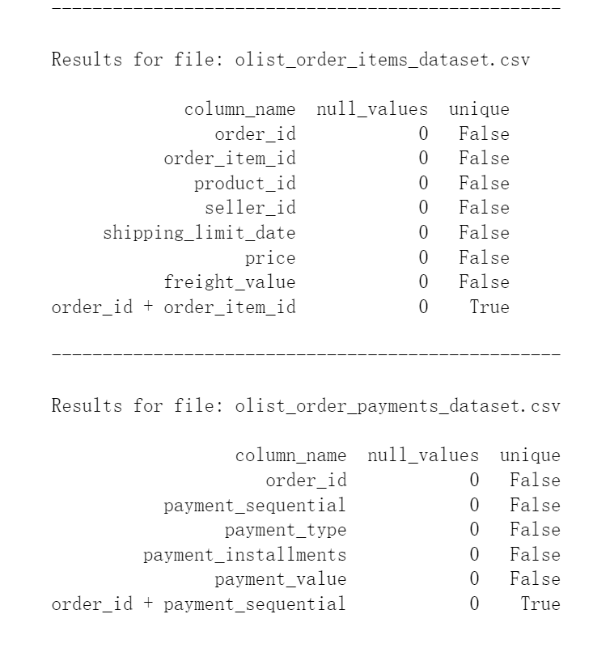
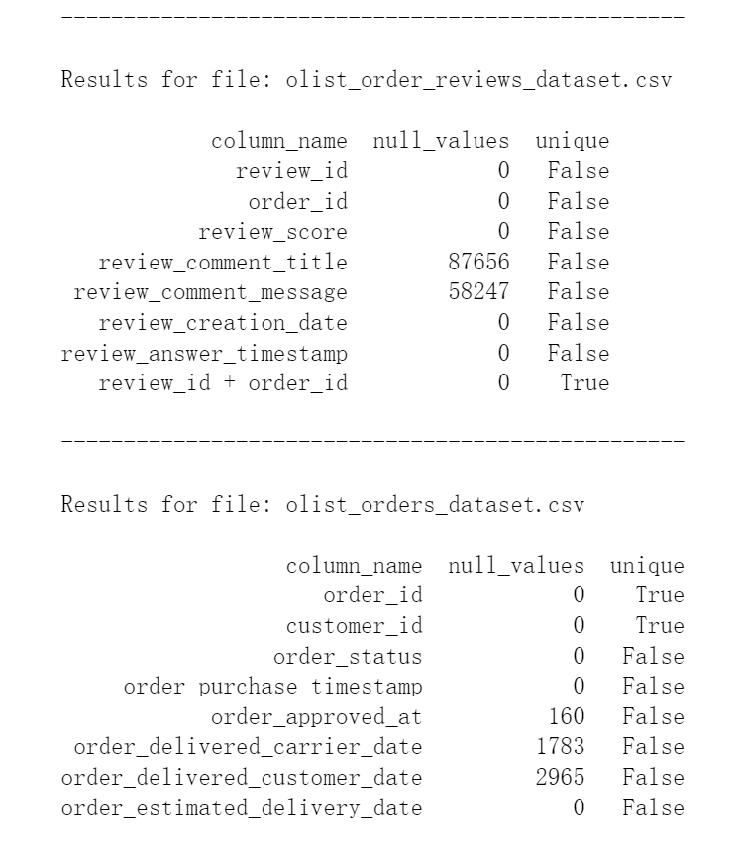
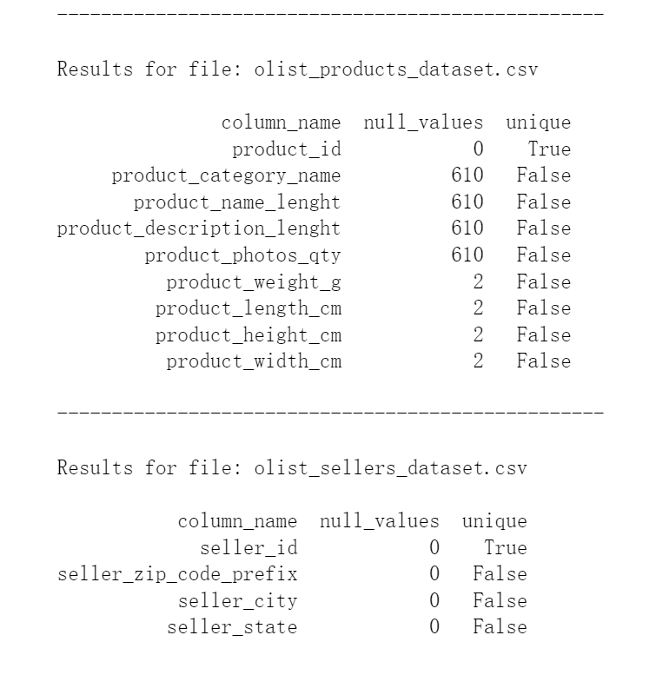
Before creating the ERD diagram
1
4
6
8
2
9
7
3
5
Have run checks on datasets:
How many the null values (if any)? and
Whether the columns contain unique values or not
For the geolocation dataset -> Since there are no unique values, and this table does not add much value as we are not using the geolocation latitude and geolocation longitude => Thus we will be dropping this table.

Slide 4
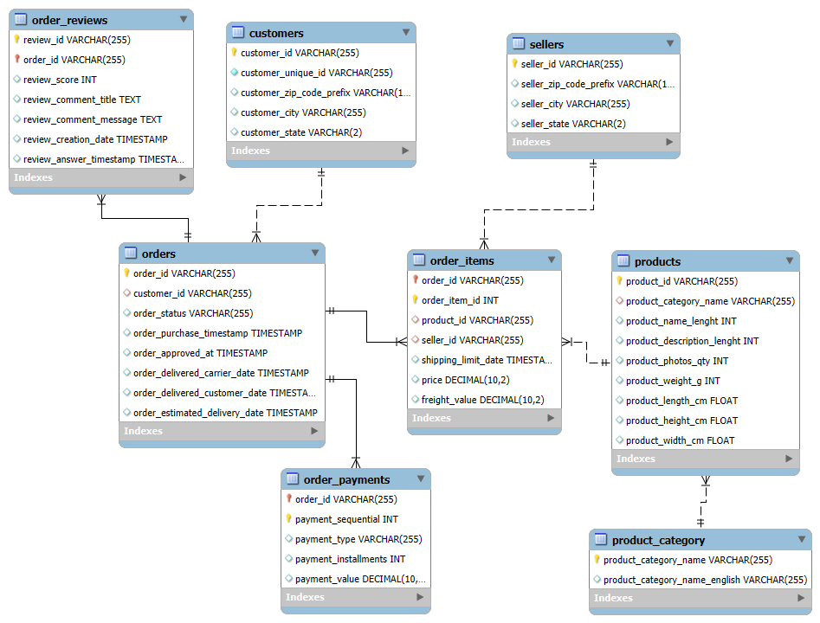
ER diagram

Slide 5
Table Description
customers
COLUMN_NAME | COLUMN_TYPE | IS_NULLABLE | COLUMN_KEY | COLUMN_COMMENT
customer_city | varchar(255) | YES |  | City of the customer
customer_id | varchar(255) | NO | PRIMARY | Unique identifier per customer of each order
customer_state | varchar(2) | YES |  | State of the customer
customer_unique_id | varchar(255) | NO |  | Unique identifier for each customer
customer_zip_code_prefix | varchar(10) | YES |  | Prefix of zip code for customer
2. sellers
COLUMN_NAME | COLUMN_TYPE | IS_NULLABLE | COLUMN_KEY | COLUMN_COMMENT
seller_city | varchar(255) | YES |  | City of the seller
seller_id | varchar(255) | NO | PRIMARY | Unique identifier for each seller
seller_state | varchar(2) | YES |  | State of the seller
seller_zip_code_prefix | varchar(10) | YES |  | Prefix of zip code for seller
3. orders
COLUMN_NAME | COLUMN_TYPE | IS_NULLABLE | COLUMN_KEY | COLUMN_COMMENT
customer_id | varchar(255) | YES | FOREIGN | Foreign key to customers table
order_approved_at | timestamp | YES |  | Timestamp of when the order was approved
order_delivered_carrier_date | timestamp | YES |  | Timestamp of when the order was delivered to the carrier
order_delivered_customer_date | timestamp | YES |  | Timestamp of when the order was delivered to the customer
order_estimated_delivery_date | timestamp | YES |  | Estimated delivery date for the order
order_id | varchar(255) | NO | PRIMARY | Unique identifier for each order
order_purchase_timestamp | timestamp | YES |  | Timestamp of when the order was purchased
order_status | varchar(255) | YES |  | Current status of the order

Slide 6
Table Description
4. order_items
COLUMN_NAME | COLUMN_TYPE | IS_NULLABLE | COLUMN_KEY | COLUMN_COMMENT
freight_value | decimal(10,2) | YES |  | Freight value for the item
order_id | varchar(255) | NO | PRIMARY | Foreign key to orders table
order_item_id | int | NO | PRIMARY | Unique identifier for each item in an order
price | decimal(10,2) | YES |  | Price of the item
product_id | varchar(255) | YES | FOREIGN | Foreign key to products table
seller_id | varchar(255) | YES | FOREIGN | Foreign key to sellers table
shipping_limit_date | timestamp | YES |  | Deadline for shipping the item
5. products
COLUMN_NAME | COLUMN_TYPE | IS_NULLABLE | COLUMN_KEY | COLUMN_COMMENT
product_category_name | varchar(255) | YES | FOREIGN | Foreign key to product_category table
product_description_lenght | int | YES |  | Length of product description
product_height_cm | float | YES |  | Height of the product in centimeters
product_id | varchar(255) | NO | PRIMARY | Unique identifier for each product
product_length_cm | float | YES |  | Length of the product in centimeters
product_name_lenght | int | YES |  | Length of product name
product_photos_qty | int | YES |  | Quantity of product photos
product_weight_g | int | YES |  | Weight of the product in grams
product_width_cm | float | YES |  | Width of the product in centimeters
6.product_category
COLUMN_NAME | COLUMN_TYPE | IS_NULLABLE | COLUMN_KEY | COLUMN_COMMENT
product_category_name | varchar(255) | NO | PRIMARY | Category name in Portuguese
product_category_name_english | varchar(255) | YES |  | Category name in English

Slide 7
Table Description
7. order_payments
COLUMN_NAME | COLUMN_TYPE | IS_NULLABLE | COLUMN_KEY | COLUMN_COMMENT
order_id | varchar(255) | NO | PRIMARY | Foreign key to orders table
payment_installments | int | YES |  | Number of payment installments
payment_sequential | int | NO | PRIMARY | Sequential identifier for each payment in an order
payment_type | varchar(255) | YES |  | Type of payment (e.g., credit card, voucher)
payment_value | decimal(10,2) | YES |  | Total value of the payment
8. order_reviews
COLUMN_NAME | COLUMN_TYPE | IS_NULLABLE | COLUMN_KEY | COLUMN_COMMENT
order_id | varchar(255) | NO | PRIMARY | Foreign key to orders table
review_answer_timestamp | timestamp | YES |  | Timestamp when the review was answered
review_comment_message | text | YES |  | Full review comment
review_comment_title | text | YES |  | Title of the review comment
review_creation_date | timestamp | YES |  | Timestamp when the review was created
review_id | varchar(255) | NO | PRIMARY | Unique identifier for each review
review_score | int | YES |  | Rating score of the review

Slide 8
Why we use Database Set-up (SQLite3)?
Pros | Cons
Easy to set up. Light weight and fast query speed. Portable. Which means there is no need to set up DBMS server. Easily accessible via third party tools (DB Browser, sqlite3 library in Python, etc). Mostly suitable for use cases where data volume is small. | Challenging for multiple users to execute queries at the same time -> Difficult to run data operations in parallel. Not suitable for use cases where data volume is huge. Not so feature-rich like other DBMS like MySQL or PostgreSQL.

Slide 9
Data Analysis and Visualization
Using Python and Tableau for analysis and visualization.
To look at the profit, sales, and quantity we deep dive into:
Customer segmentation
Product categories
Cities
Customer reviews based on delivery
Delivery time
Methods of payments

Slide 10
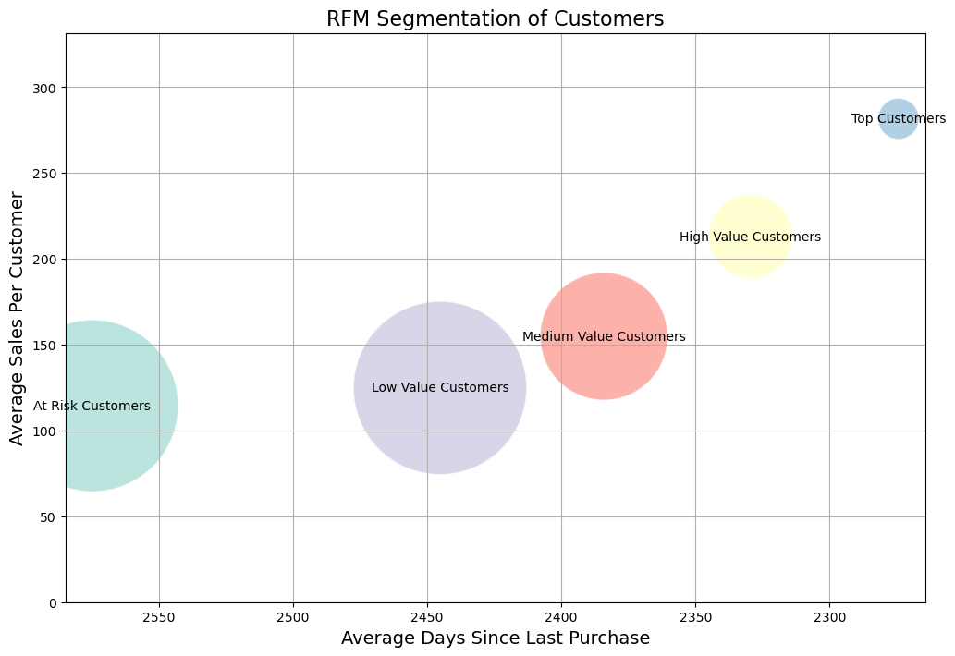
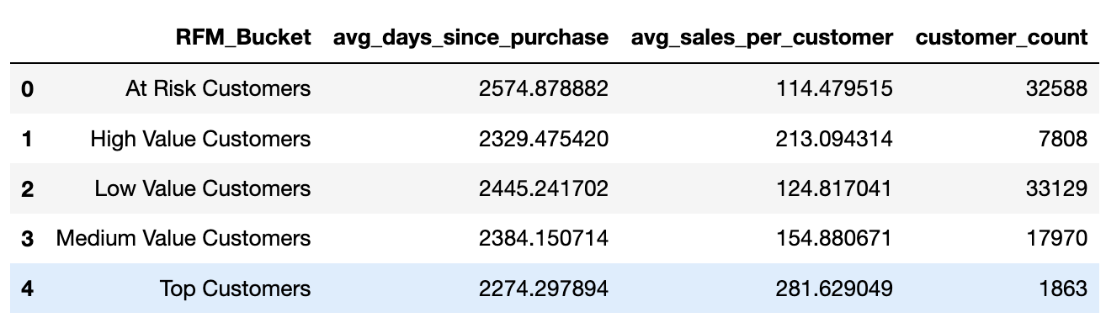
RFM scoring was used to calculate
Recency: the last time a customer makes a purchase
Frequency: the number of times a customer has purchased from Olist
Monetary: the total amount of money a customer spends
Customers were then given scoring (1 to 5) for each of the RFM metric above and grouped into 5 different segments
Top Customers (High R/ High M/ High F)
High Value (Medium to High R/ Medium to High F/ Medium to High M)
Medium Value (Medium R/ Medium F/ Medium M)
Low Value (Low to Medium R/ Low to Medium F/ Low to Medium M)
At Risk (Low R/ Low F/ Low M)
Understanding customer segmentation can help Olist strategize different marketing strategies to target each customer segment to maximize customer loyalty and sales.
Customer Segmentation

Slide 11
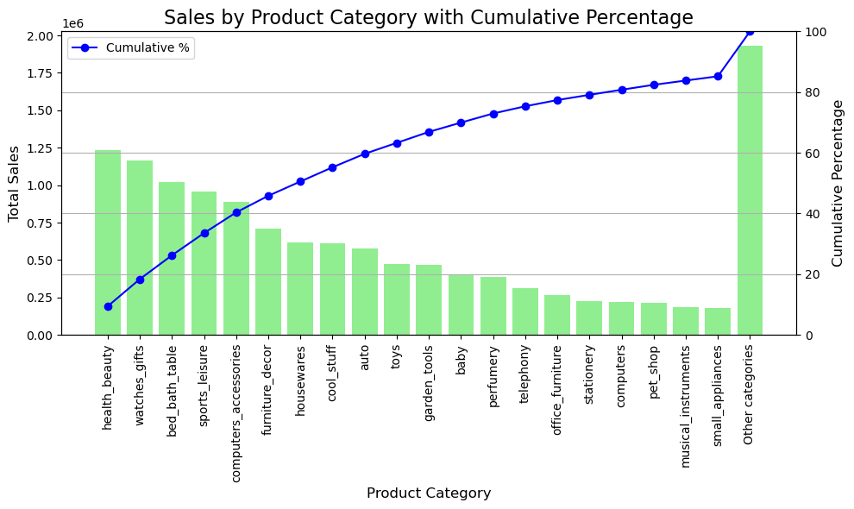
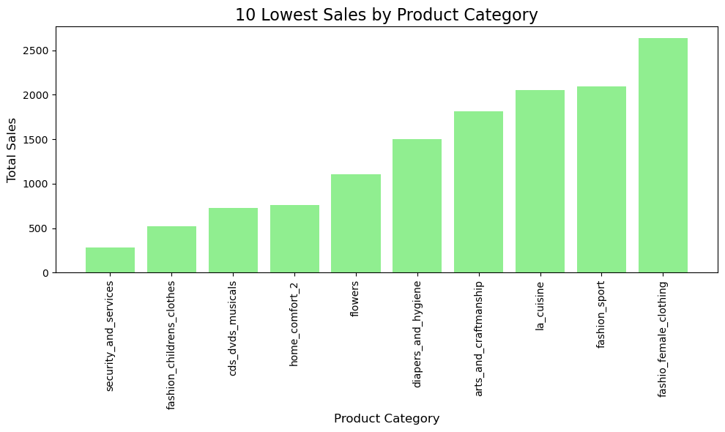
Highest and Lowest Sales by Product Category
Top 20 product categories contribute 85% of the total revenue.
Having insights of the product categories that generate the highest and lowest sales could also help us make better business decisions to optimize the inventory to ensure there is optimal supply of products to match the demand.
Understand which product categories are crucial and need more attention for Olist business and channel its resources more towards marketing, promoting those products in particular
Such as promoting popular products in categories like health beauty / watches to get more traffic to the website

Slide 12
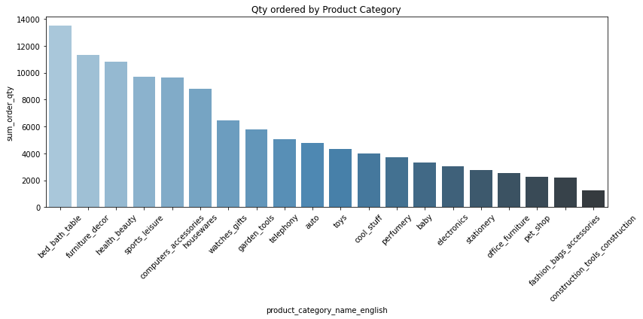
Top 5 quantity sales in the product category
Top 5 quantity of orders are for products in these categories:
Bed bath table / furniture decor / health beauty / sports leisure / computers accessories
Focus on these categories and deep dive into the quantity sales across the months and years to see if there is any trend.
To see if there are any complementary categories
For example: To bring up the sales of electronics, perhaps promotion should tie with computer accessories which can lead to a win-win in terms of boasting the sales for both categories.

Slide 13
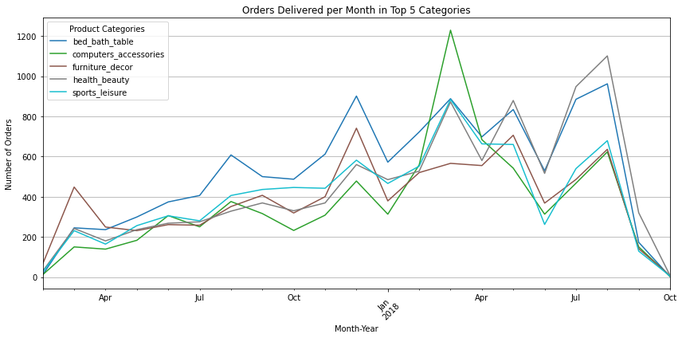
Trends for the Top 5 quantity sales
Note:
Plotted this trend from Jan 2017 onwards due to noisy data before Jan 2017.
From the top 5 categories, there is a greater spike in computer accessories in the period between Jan to Mar 2018 as the number of orders reached a peak of 1200+ in Mar 2018.
An upward trend for these categories from Jan 2017 to Mar 2018.
Comparing Q3 in 2017 to 2018, there seems to be a sharper drop of quantities ordered in 2018 as compared to 2017.
Important to relook at the marketing, pricing strategies as well as customer sentiments to see what have changed to prevent sales decline.

Slide 14
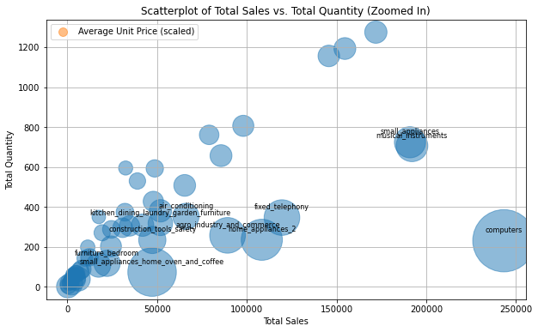
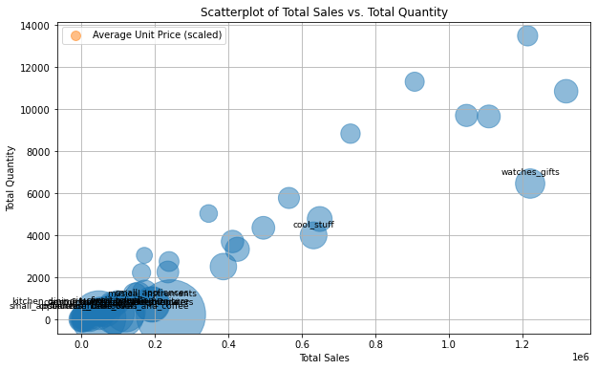
Relationship between total sales, total qty and average unit price of product in each category
NOTE:
Only Top 20% of the highest average unit price of the product in each category is annotated.
The bigger the circle, the higher the average unit price.
Segment the product categories:
High sales, high quantity with higher-than-average unit price: watches gifts
Mid sales, mid quantity with higher-than-average unit price: cool stuff
Low sales, low quantity with high average unit price: computer, small appliances home oven and coffee
Recommendations:
Focus our marketing campaign efforts to promote those products with low sales, low quantity sales but with high average unit price to bump up sales fast.
A marketing push for high-priced items can elevate brand perception, attracting customers who associate higher prices with better quality.

Slide 15
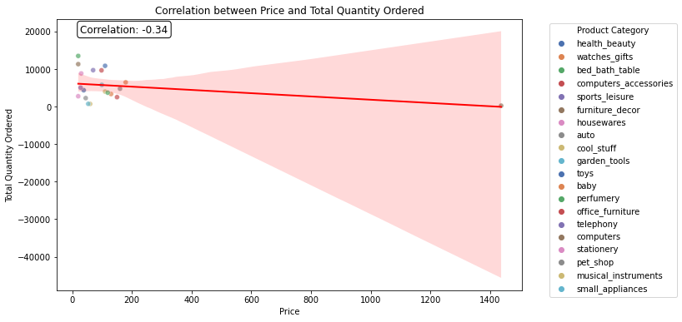
Correlation between price and sales quantity
-0.34 correlation: There is a weak negative relationship between price and total quantity ordered.
If the prices of the products increase, there is a tendency for the number of quantity ordered to decrease.
Higher prices may deter consumers from buying more of the products, thus sellers are encouraged to reduce prices to clear their stocks.

Slide 16
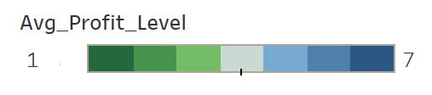
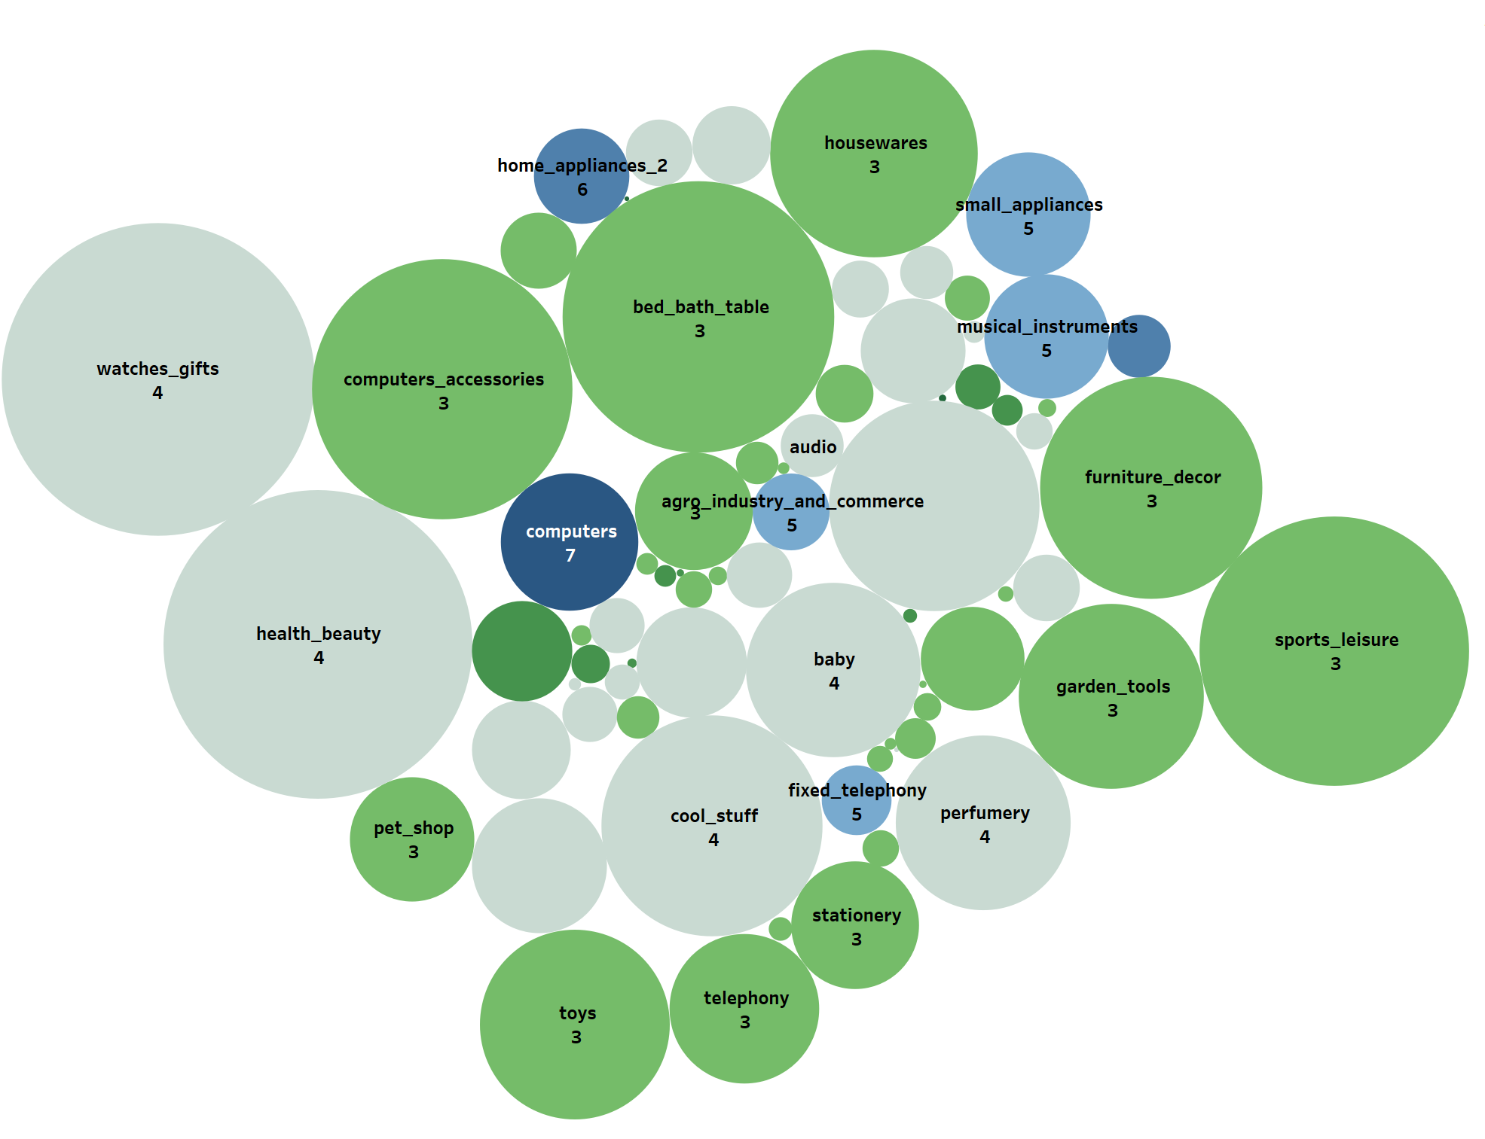
Which product is most profitable？
Which products are the most profitable in terms of total profit and average profit?
L1: AP < 25
L2: 25 <= AP < 50
L3: 50 <= AP < 100
L4: 100 <= AP < 200
L5: 200 <= AP < 400
L6: 400 <= AP < 800
L7: AP >= 800
Total Profit (Bubble Size) = Total Price – Total Freight Value
Average Profit (AP)= Total Profit / Numbers of Products
Computers have a lower volume compared to high-total-profit products, despite their highest unit profit.
This could be due to factors like higher pricing, niche markets, or less frequent purchases.
Most high-total-profit products are in average profit levels 3 and 4.
This implies that products with a moderate unit profit and higher sales volume can often achieve higher overall profitability.
Recommendations
Product Mix Analysis: Evaluate the overall product mix and consider adjusting the portfolio to focus on products with higher profit margins.
Visualization from Tableau

Slide 17
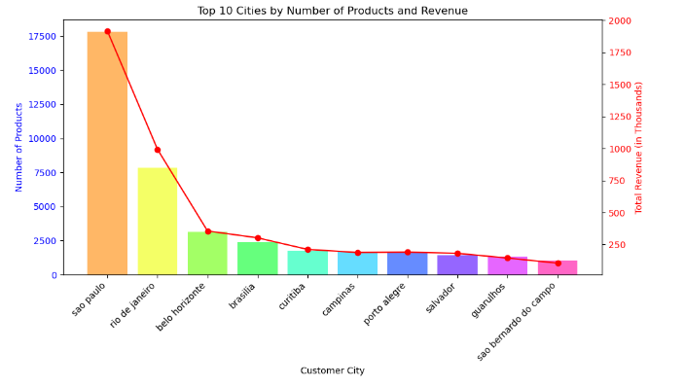
Top 10 cities with the highest number of products and highest revenue
The ranking of the Top 10 cities with the highest product quantity and highest revenue is the same.
Sao Paulo leads by a wide margin in both revenue and product volume, which is almost twice as many as Rio De Janeiro.
But there is a steep decline in both number of products and revenue after the top two cities, which seems to be a problem with sales outside the metropolitan areas.
Recommendations
Conduct local market research: To understand the specific needs and preferences of consumers in cities outside Sao Paulo and Rio De Janeiro. This can help tailor marketing strategies and product offerings to better align with local tastes.

Slide 18
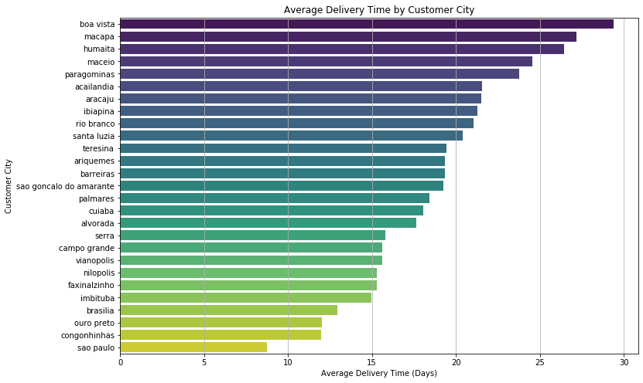
How does delivery time vary based on customer location?
This chart shows the average time it takes for deliveries to reach customers in various cities, which reflects logistics challenges in remote cities compared to major urban centers.
Cities like Boa Vista and Macapá have much longer delivery times (close to 30 days), while cities like São Paulo and Congonhinhas experience faster deliveries (around 10 days or less).
Cities like São Paulo and Rio de Janeiro perform exceptionally well in both the number of orders and revenue generation, aligning with their relatively shorter delivery times. However, cities with higher average delivery times (e.g., Boa Vista, Macapá) are not appearing in the top revenue or order counts, possibly due to the poor delivery experience.
Recommendations:
Improve Delivery Speed in Low-Performance Cities:
Cities like Boa Vista and Macapá experience very long delivery times. Reducing delivery delays in these cities through better logistics, local distribution centers, or more reliable courier services could improve customer satisfaction and potentially increase repeat orders and revenue.
Enhance Logistics in Growing Markets:
Some cities with significant potential (mid-level performers) like Brasilia, Salvador, and Curitiba show promising results in the delivery of order volume and revenue (i.e. able to cope with the scaling of orders thus increasing revenue). Invest in regional warehouses or partnerships with faster local delivery services in these cities to further boost performance.

Slide 19
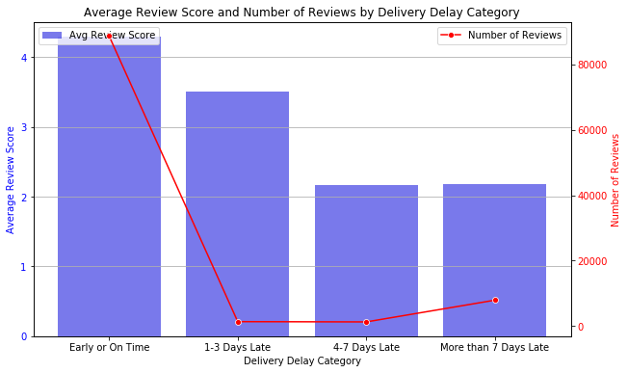
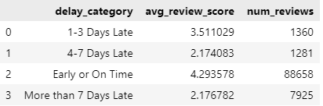
How does the delivery delay affect customer review?
This chart shows the relationship between delivery delay categories and their impact on customer reviews.
Customers are most satisfied when deliveries are early or on time, giving an average review score of 4.3, the highest rating and most willingness to give reviews.
For deliveries that are delayed more than 7 days, review scores are very low (around 2.7) and the number of reviews increases to 7925.
This suggests that long delays not only frustrate customers and are more likely to voice their opinions and express their dissatisfaction.
Recommendations
Improving Delivery Processes:
Assess the supply chain and logistics to identify bottlenecks that contribute to delays.
Implementing more efficient processes could help reduce delivery times and improve customer satisfaction.
Transparent Communication:
Keep customers informed about their order status, especially if delays are anticipated.
Proactive communication can mitigate frustration and enhance customer trust.

Slide 20
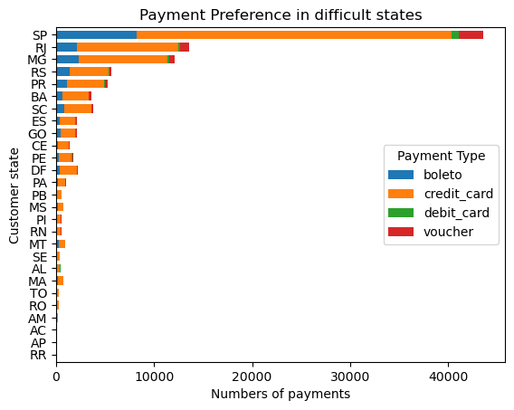
What are the preferred payment methods in different states and how do they vary in usage?
Credit card: the most popular across all states
Boleto: a popular Brazilian cash-based payment method, particularly welcomed in SP
Vouncher: more concentrated presence in states like SP & RJ.
Debit card: seems to be minimal usage
Recommendations
Optimize Payment Options: Credit card is the primary payment method. However, consider offering Boleto as an alternative option, especially in states where they have significant usage.
Promote Voucher: If there's a strategic reason to promote voucher usage, explore targeted campaigns or incentives in states where it's currently underutilized.

Slide 21
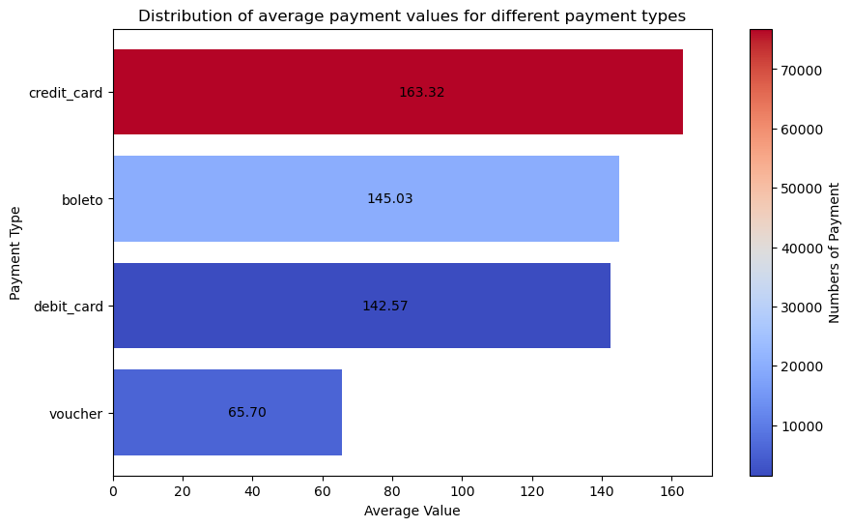
What is the average payment value for each payment type and how do they compare to each other?
Number of payments is mostly positively-correlated with the average payment value.
The higher average value for credit card payments might indicate that customers are more likely to make larger purchases or have impulse buys when using this method.
The lower average value for voucher payments could be due to restrictions on the types of products or services purchased with vouchers.
Recommendations
Pricing Strategies: Consider adjusting pricing strategies based on the payment method used. For example, you might offer discounts or promotions for customers using Boleto or debit card.
Customer Segmentation: Segment customers based on their preferred payment methods and tailor marketing and product offerings accordingly.

Slide 22
Recommendations
Based on customer segmentation insights,
Olist can implement exclusive loyalty programs for top customers and high value customers by offering store points, early access to new products, free delivery or exclusive discounts to retain them and encourage them to make more purchases.
As for medium, low value and those customers who the platform is at risk of losing them, Olist can increase customer engagement through personalized emails or SMS, conduct survey for feedback or provide bundle deals based on their last purchases.
Based on product categories below and have target marketing strategies to boast sales:
High sales but low profit margin: Big bath table, sports leisure
Low sales but high profit margin: Home appliances
High sales and high profit margin: Computers, small appliances, musical instrument
Cities:
Cities like São Paulo and Rio de Janeiro perform exceptionally well in both the number of orders and revenue generation, and they have shorter delivery times. Based on top cites (mainly the metropolitan ones such as Sao Paulo and Rio De Janeiro), the platform should allocate more marketing resources to cities if they have already sold a significant number of product.
When customers are more satisfied with when the order is delivered on time with no delays, this would encourage customers to buy more things from the platform again. It will be helpful to implement more efficient processes to reduce delivery times and improve customer satisfaction.
However, cities with higher average delivery times (e.g., Boa Vista, Macapá) are not appearing in the top revenue or order counts, possibly due to the poor delivery experience. Improve on the delivery processes and to prevent delivery delays so that customers can have greater satisfaction.
Giving incentives to the consumers to use credit card as well as Boleto since both payment methods are the top choices for consumers.

Slide 23
Future work
Analyzing product categories and their contributions to sales can enhance predictive analytics, such as Market Basket Analysis (MBA), by allowing us to concentrate on high-performing categories and uncover valuable product relationships for further investigation.
Explore the growth potential in terms of sales for some of the low sales cities.
Create targeted marketing campaigns that resonate with the community’s culture and values.
Leverage local media channels and social media platforms to increase awareness of the platform, positioning it as a top choice for consumers when they’re looking to make purchases.
Introduce singles day promotion like 10.10 and 11.11 to have massive discounts and thereby encourage a lot of spending and can increase the sales volume significantly.
Look at the seller's dataset to see where are most sellers situated
Sales contributed by several big sellers or by many small sellers => to gauge the risk that the platform may take in case 1 big seller is removed from the platform

Slide 24
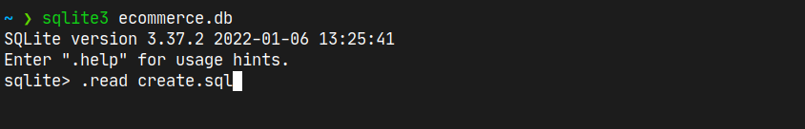
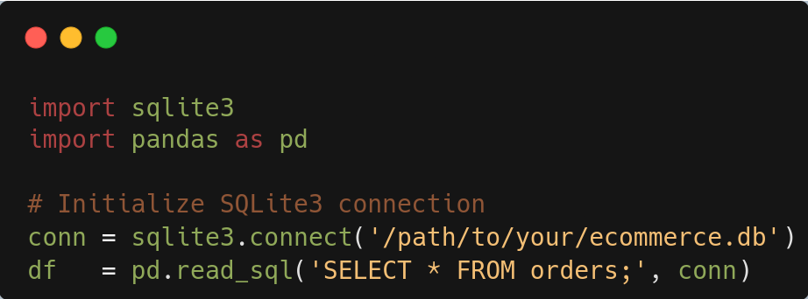
Appendix – DB Setup and Connection
From the SQLite3 console, run the create.sql script:
Connect to the created database via Python sqlite3:

Slide 25
Appendix
Please find the following files via the links:
SQLite csv files for the database 'csv-20240925T144055Z-001.zip'
DB file 'ecommerce.db'
Python codes 'Project.ipynb'
Information on Brazilian E-Commerce Public Dataset by Olist (kaggle.com)

